Slide 1
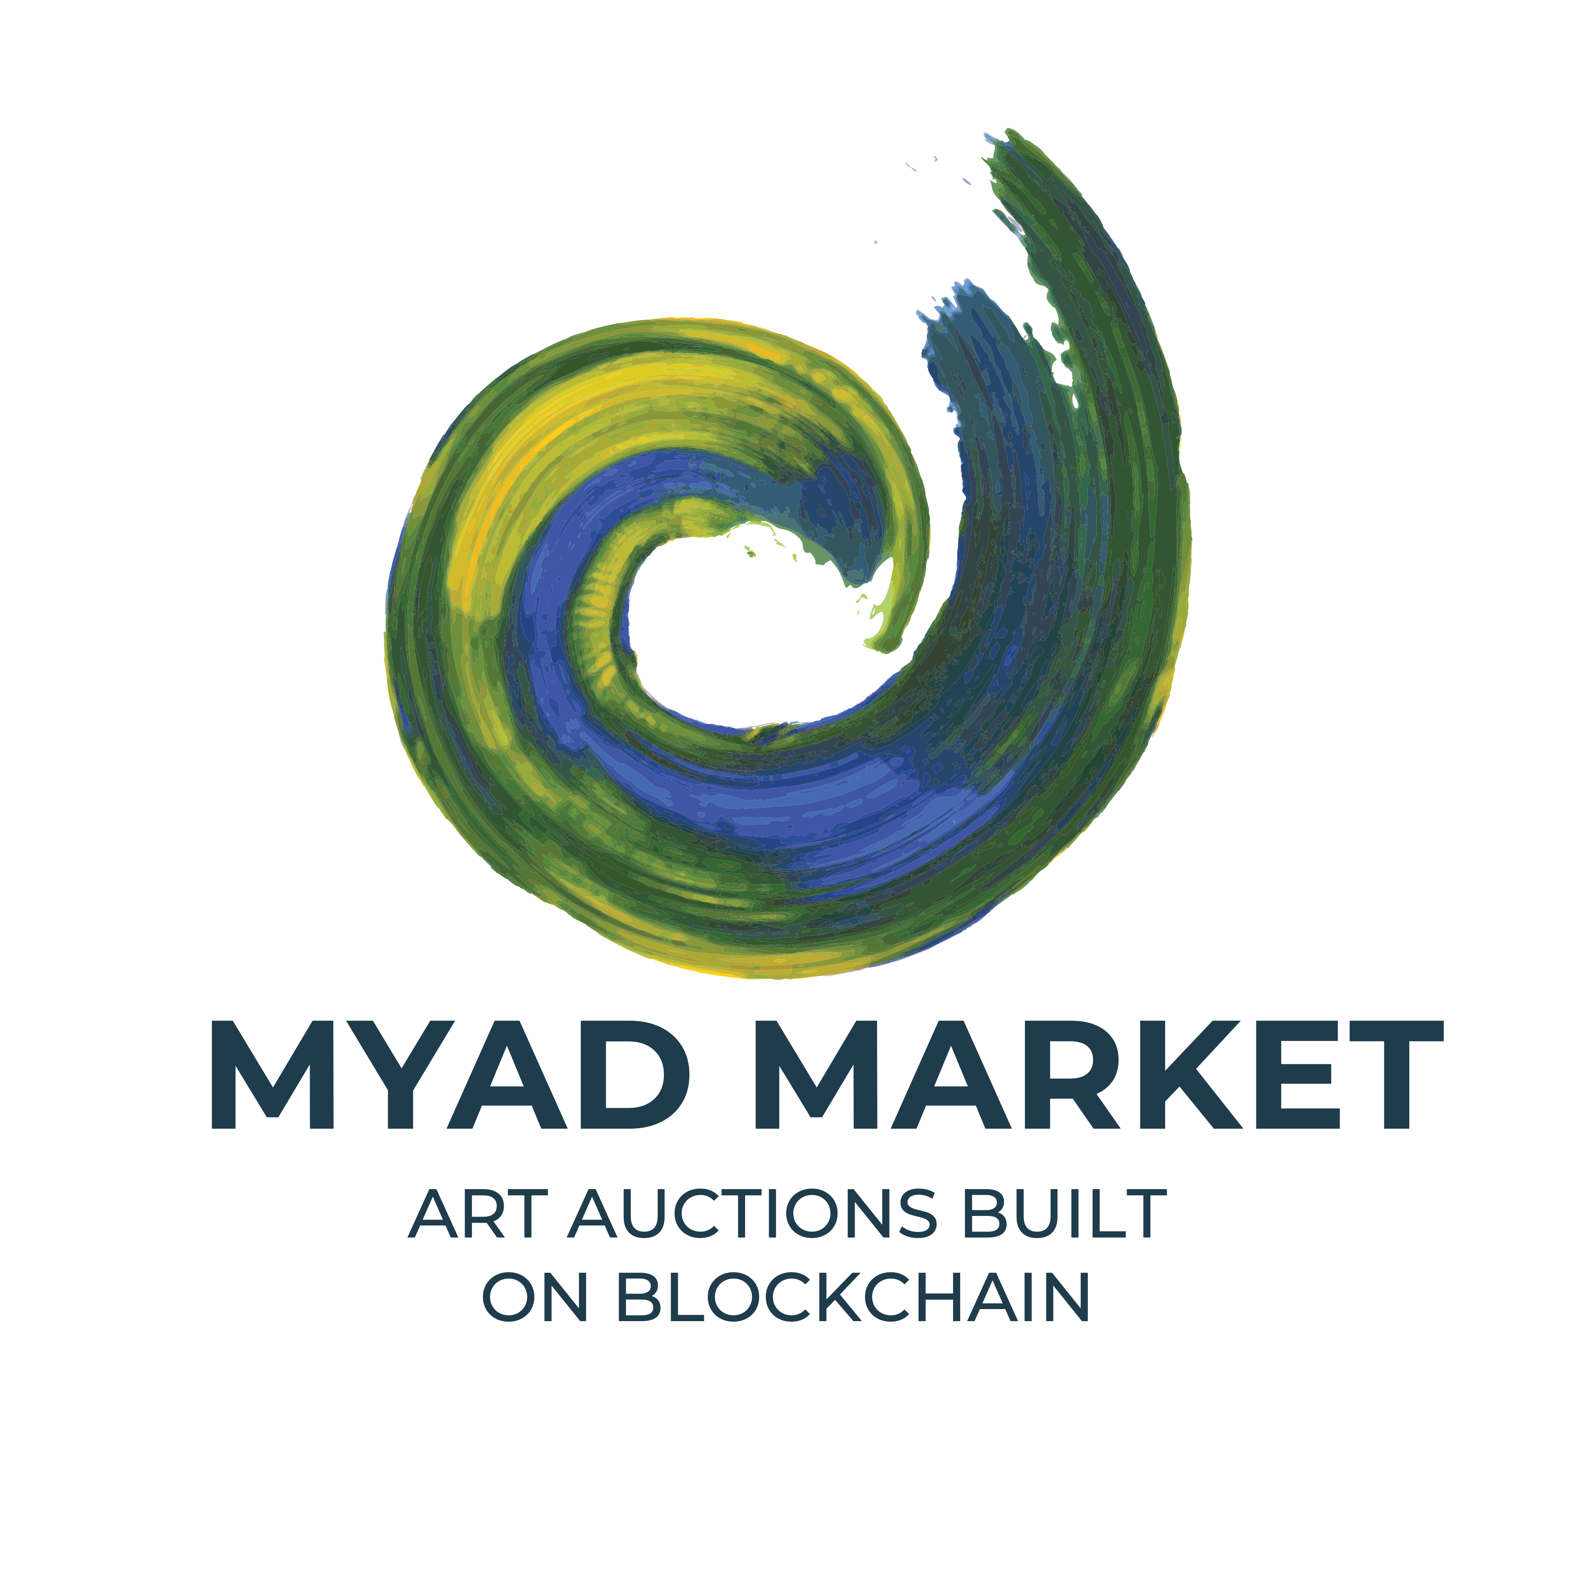
Northwestern University Fintech – Project 3
By: Drew Marnell, Apexa Patel, Yoko Yamamoto, Matt Epler

Slide 2
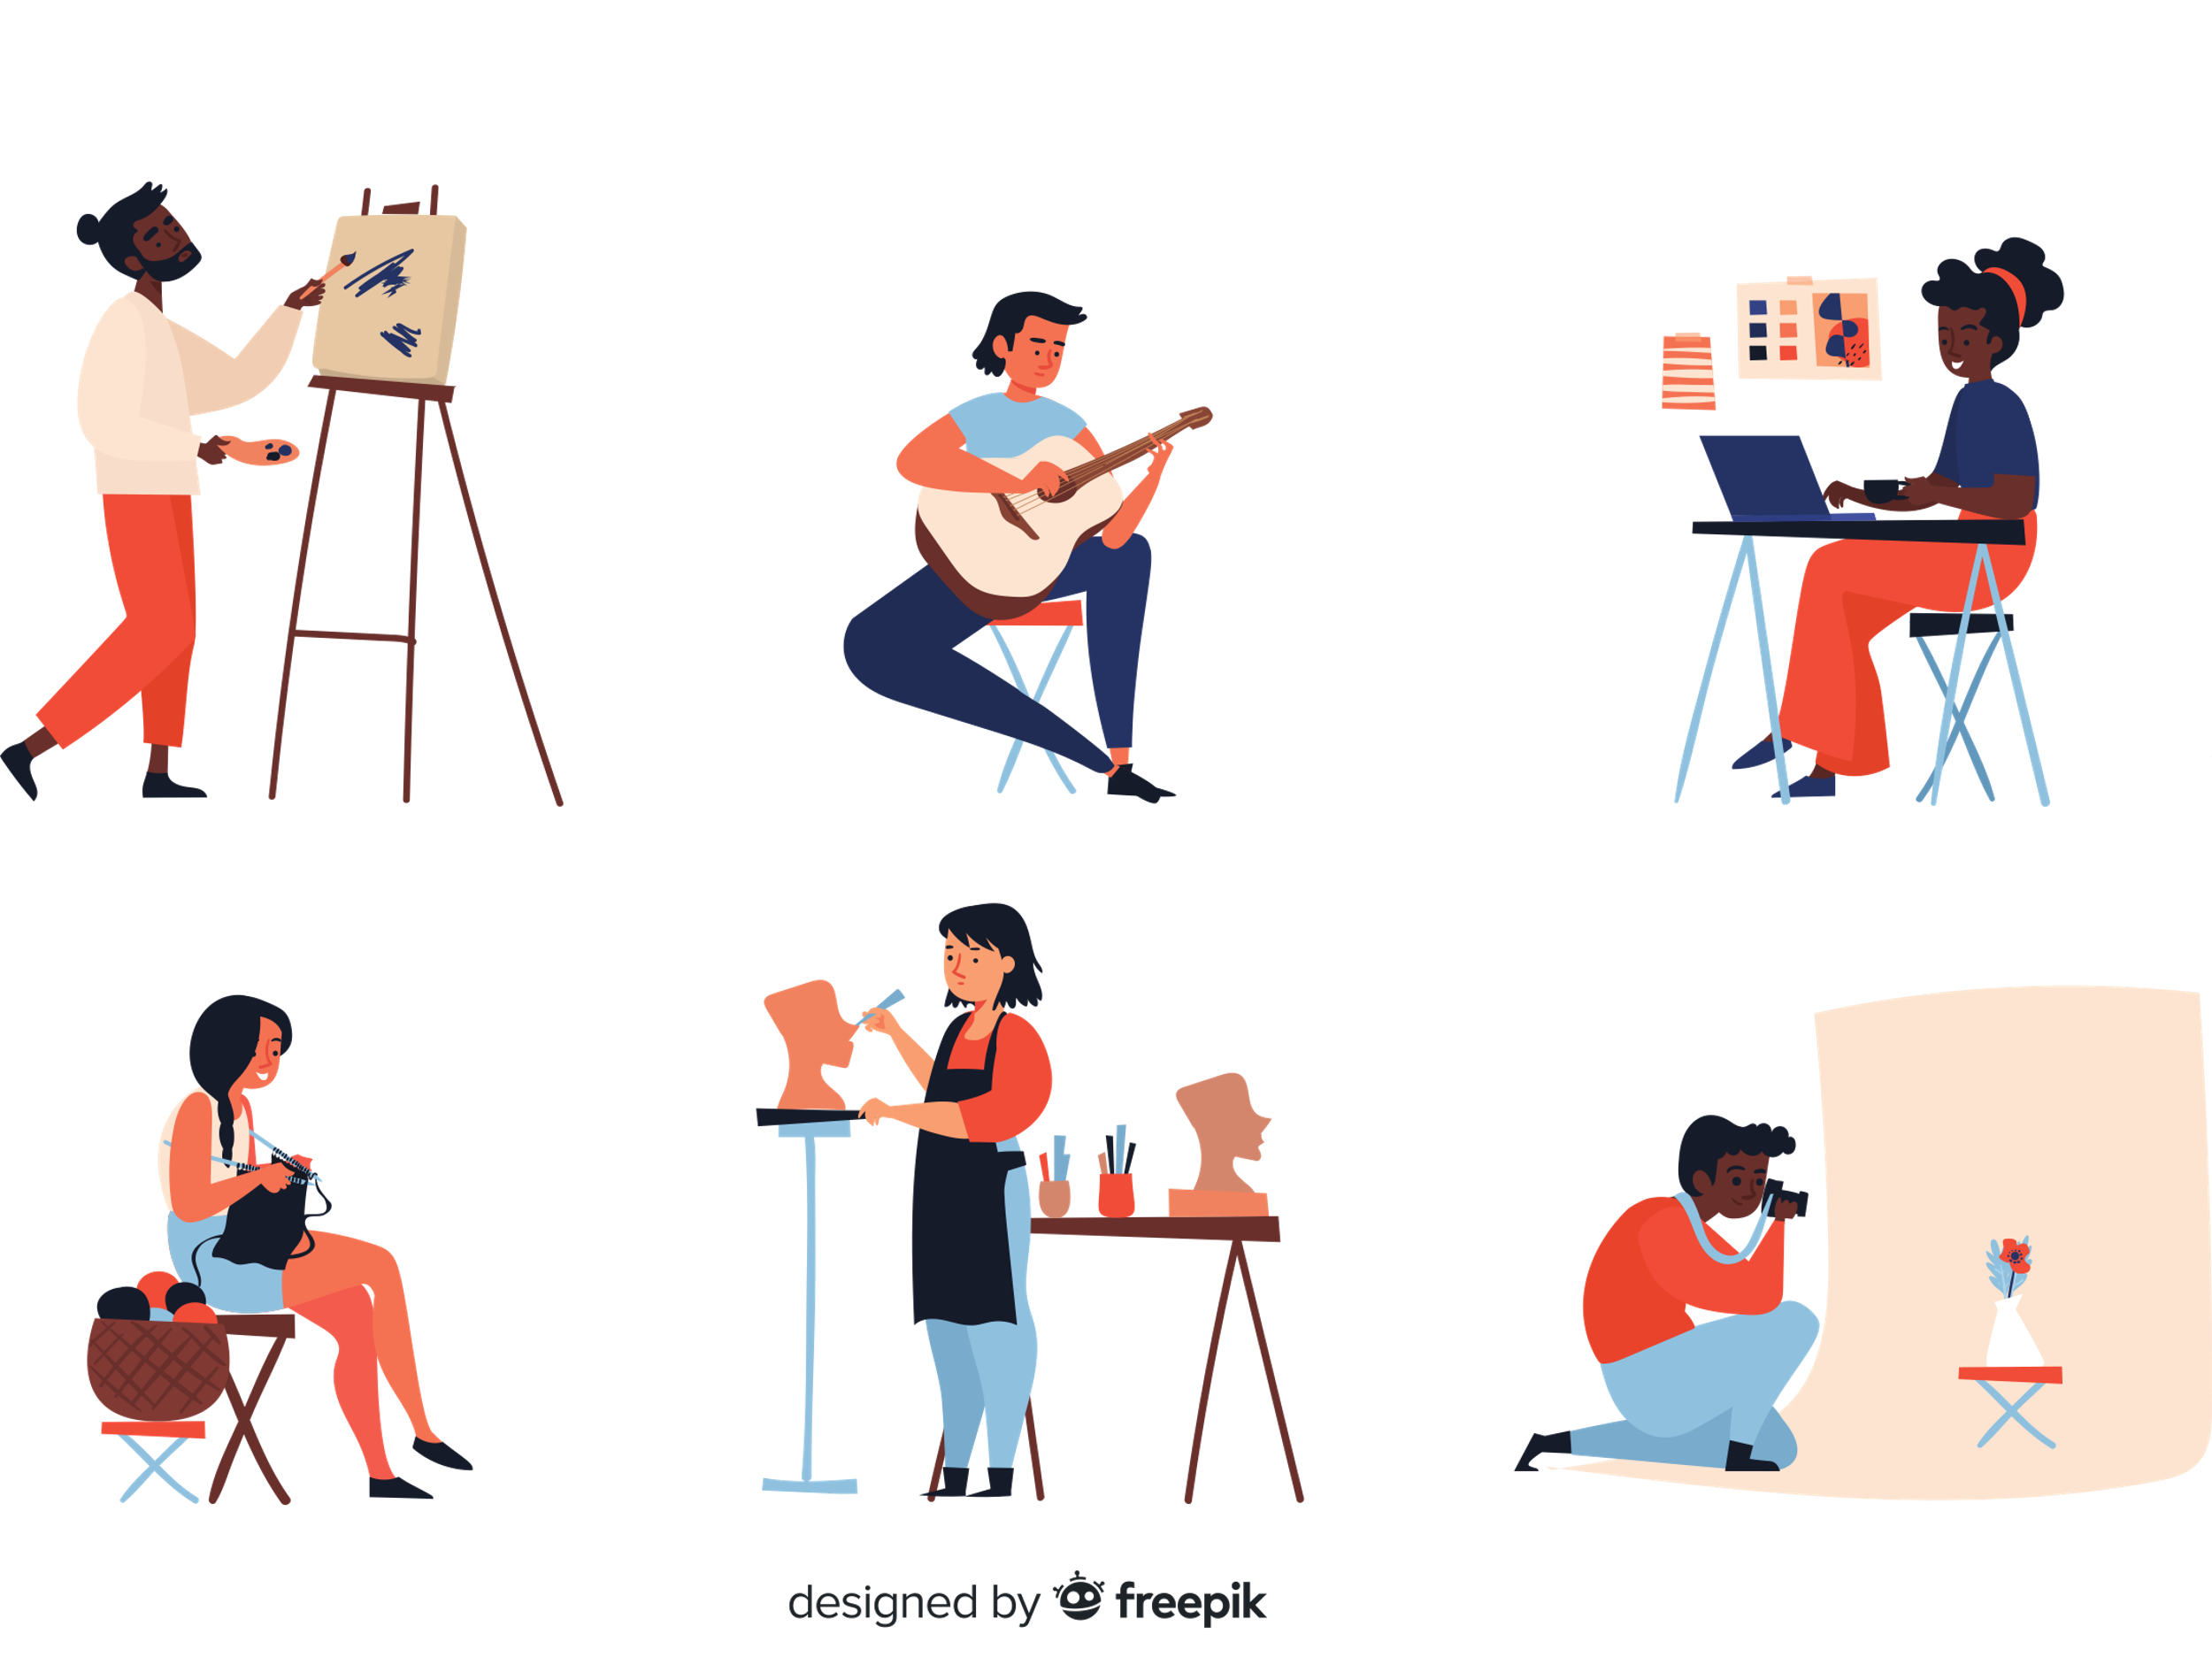
The Story
Our friends Mark and Mary are very talented artists living in different parts of the world. During our recent virtual coffee meet, they expressed some of their concerns about selling their art in stores and online.

Slide 3
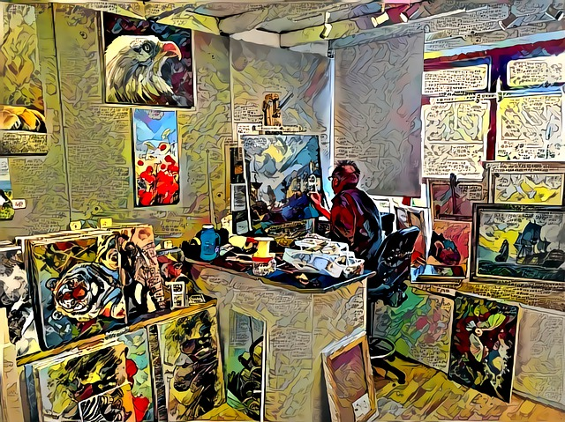
Concerns
Buying/selling physical art online
Authenticity
Intermediation
Customer Satisfaction
Fees
Companies like Etsy and eBay are making a killing on small and big artists.
- Listing fees
- Transaction fees
- Payment processing fees
- Marketing fees

Slide 4
Blockchain
We think that with our knowledge of solidity, we can help artist like Mark and Mary by creating an efficient peer-to-peer marketplace without any middlemen for artists to sell directly to their peers in a more open and equitable way.

Slide 5
Flowchart

Slide 6
The Art Registration
Artist:
Mark and Mary can now simply create their accounts on MYAD Market.
Upload artwork details and evidence of authenticity.
MYAD Market (Auction House):
Create a .json file with artwork details and evidence.
Store artwork information on IPFS and generate URI to reduce the gas cost.
Use URI to create artwork token.

Slide 7
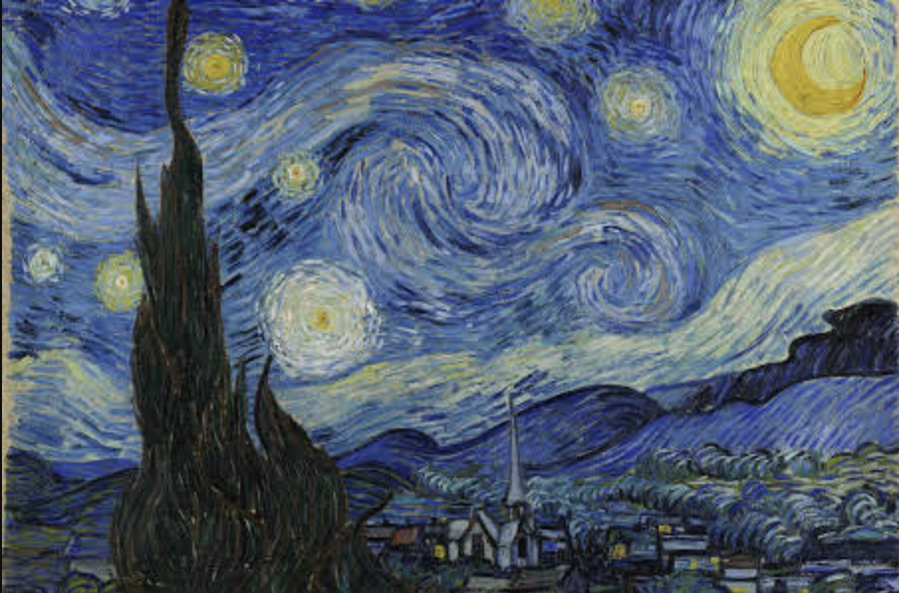
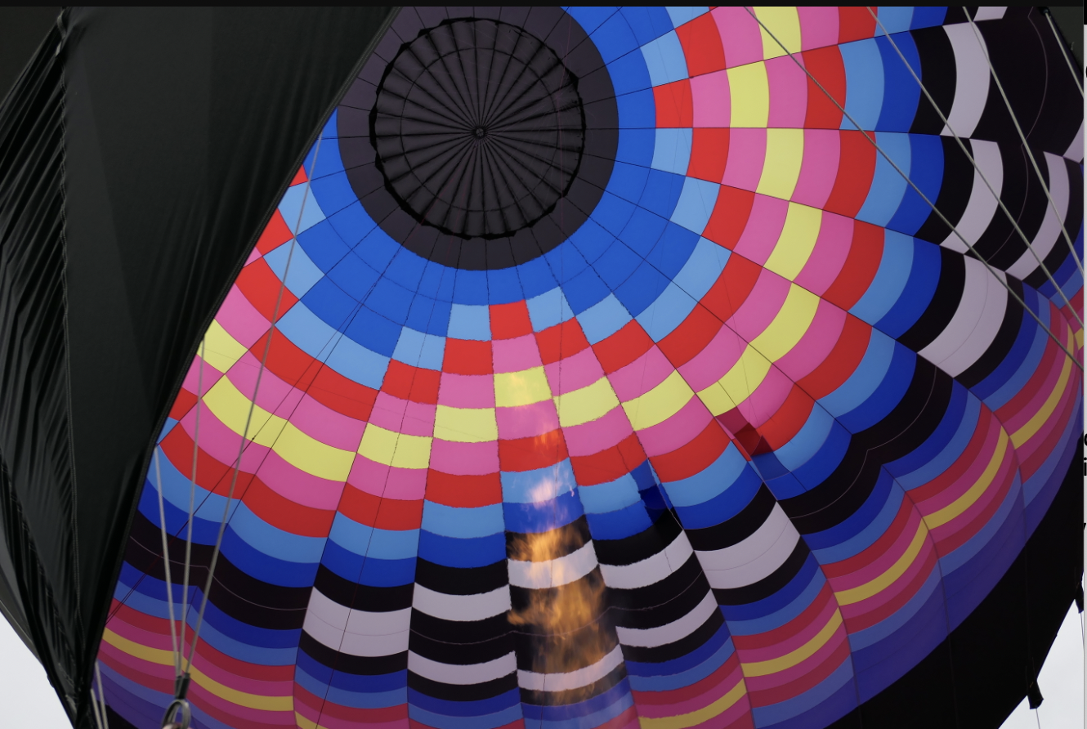
The Art Registration Let’s register two pieces of art for illustration purposes.
Art: 1
Art: 2
"Name": "Starry Night”
"Artist": "Vincet van Gogh"
"Year": "1889"
"OriginCountry": "Netherlands"
"Medium": "Oil on canvas" "Dimensions": "73.7 cm × 92.1 cm (28.7 in × 36+1⁄4 in)"
"Description": "Moderately abstract landscape of an expressive night sky over a small hillside village"
"Image": "https://ipfs.io/ipfs/bafybeidpodhasah5yyvur5cu7fn54cmdva5b7pzby25xs4bcsxwxsosiky"
"InitialValue": "1 Billion"
"Name": “Hot Inside”
"Artist": “Yoko Yamamoto”
"Year": “2021”
"OriginCountry": “Galena Illinois, USA”
"Medium": “Digital Photo“
"Dimensions": “Any”
"Description": “Photo from the basket of a hot air balloon”
"Image": “https://ipfs.io/ipfs/bafybeiec2grfymigidqmhay73fpuxmf63ttsuji64e66hx6m4fnelgdvoe”
"InitialValue": "$10”

Slide 8
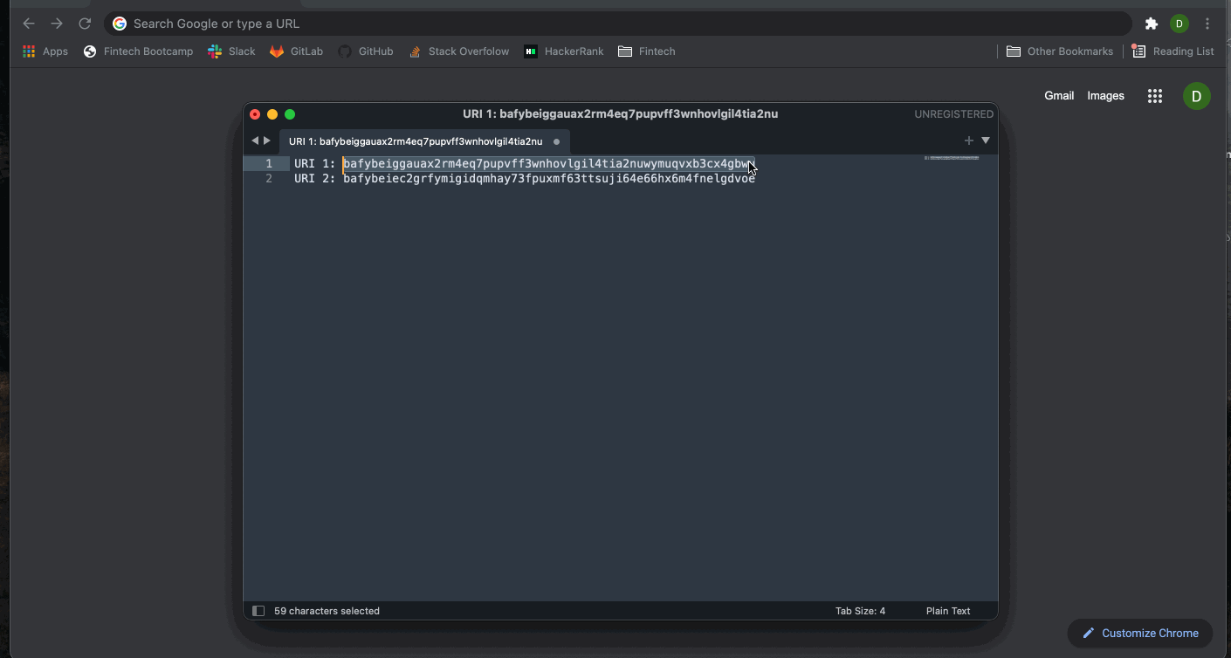
The Art Registration

Slide 9
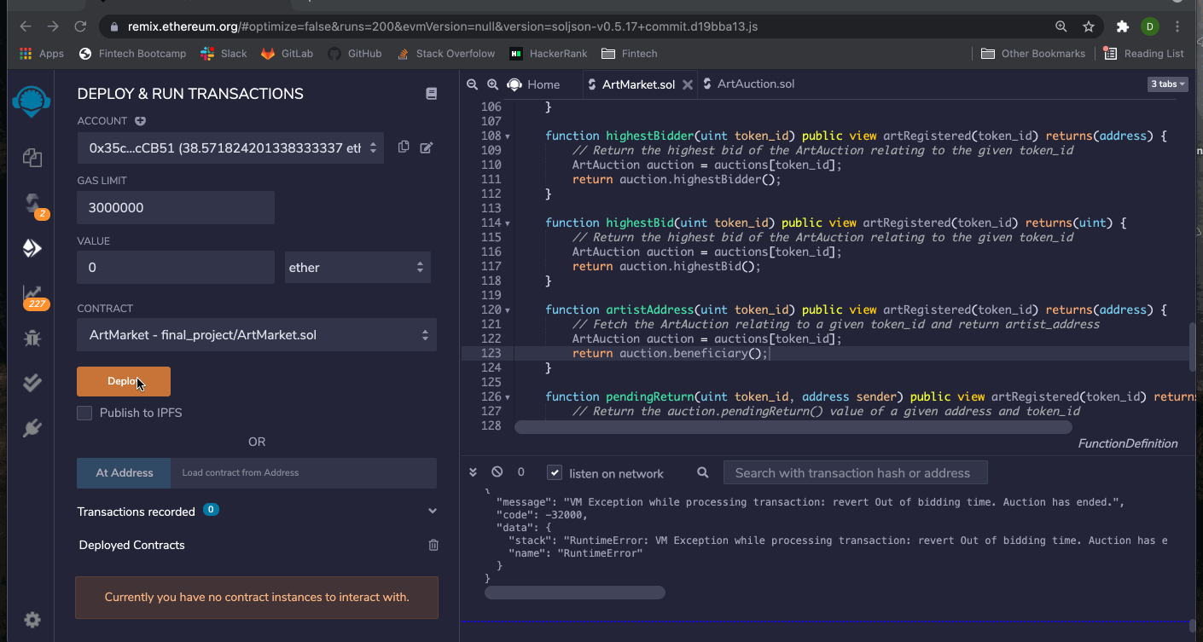
The Art Registration

Slide 10
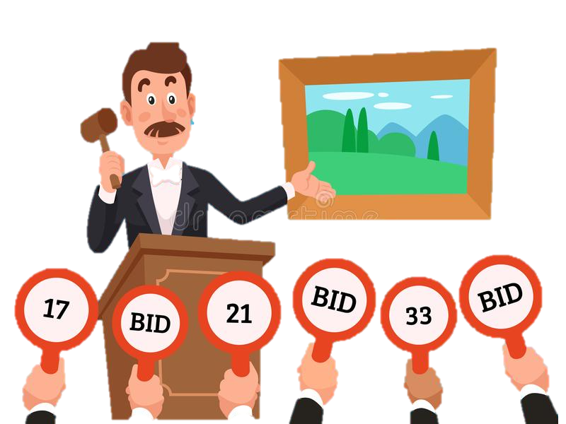
Placing Bids We have two bidders willing to buy the art on MYAD Market
Tom (Account 2) : wallet address ending E91d
Harry (Account 3): wallet address ending 07fF
Art – Token (1)
Tom - Bid value – 1 ETH
Harry - Bid value– 2 ETH
Tom - Bid Value – 3 ETH
Art - Token (2)
Tom - Bid Value – 1 ETH
Note: For the presentation purposes the bidding time is set to two minutes and the contracts were deployed on a local test network

Slide 11
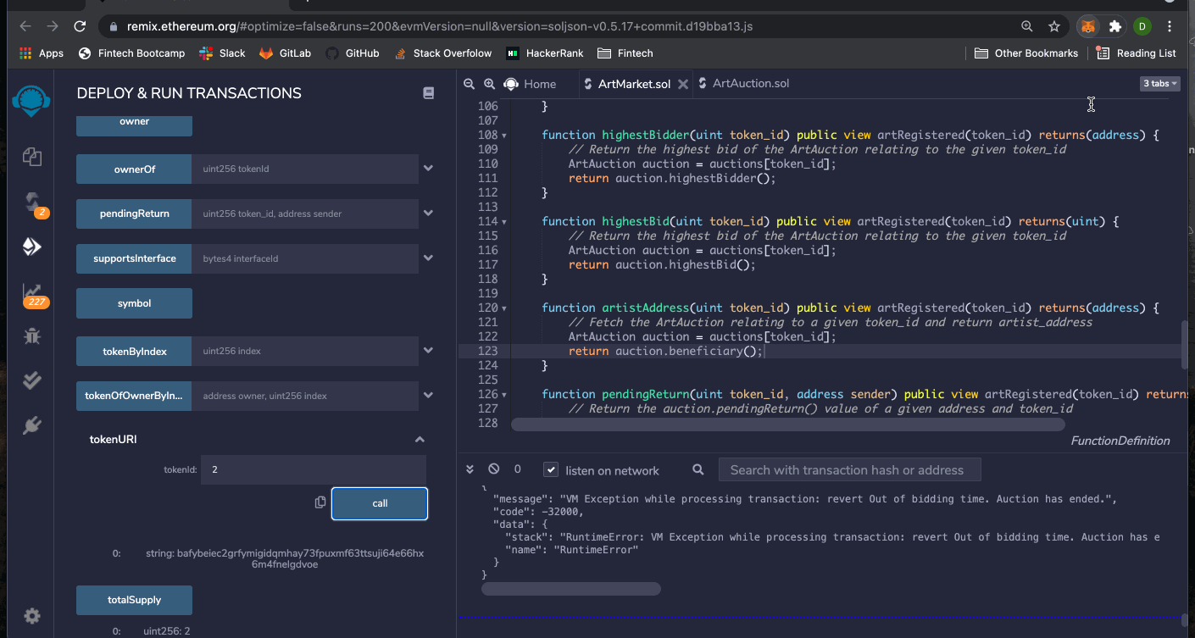
Placing Bids

Slide 12

Shipping Art To Highest Bidder
Highest Bidder of Art 1: Harry (Account 3 – O7fF), Bid Value 2 ETH
Shipped by: Artist (Account 5 – CBE9)
Notes:
After bidding is closed, the next step is to ship the artwork to the highest bidder
In our case, this is Harry

Slide 13
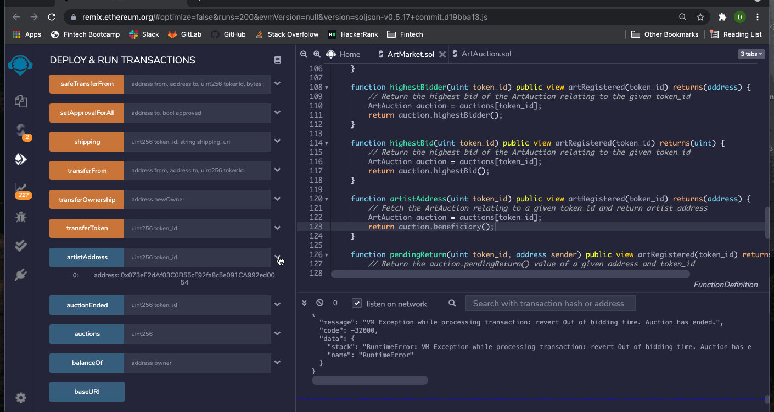
Shipping Art
Notes:
First we verify the artist address associated with token ID 1
Because Myad Market is a digital auction house, the artist must ship the art directly to the highest bidder so we switch to the artist’s address
In order to maintain transparency and visibility on the blockchain as well as traceability of the artwork itself, the artist must input the shipping information, which is then stored with a URI on the blockchain
So, as the artist (Account 5 CBE9), we input the shipping URI and associate it with token ID 1

Slide 14
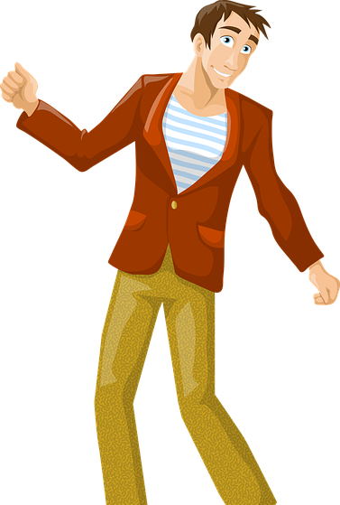
Customer Satisfaction
Harry (Account 3 – O7fF) received his Artwork and he seems to be very happy with his purchase.
Notes:
The artwork arrives safely at Harry’s shipping address and he is very pleased with his purchase
This means a couple things happen on the marketplace, all of which are saved on the blockchain

Slide 15
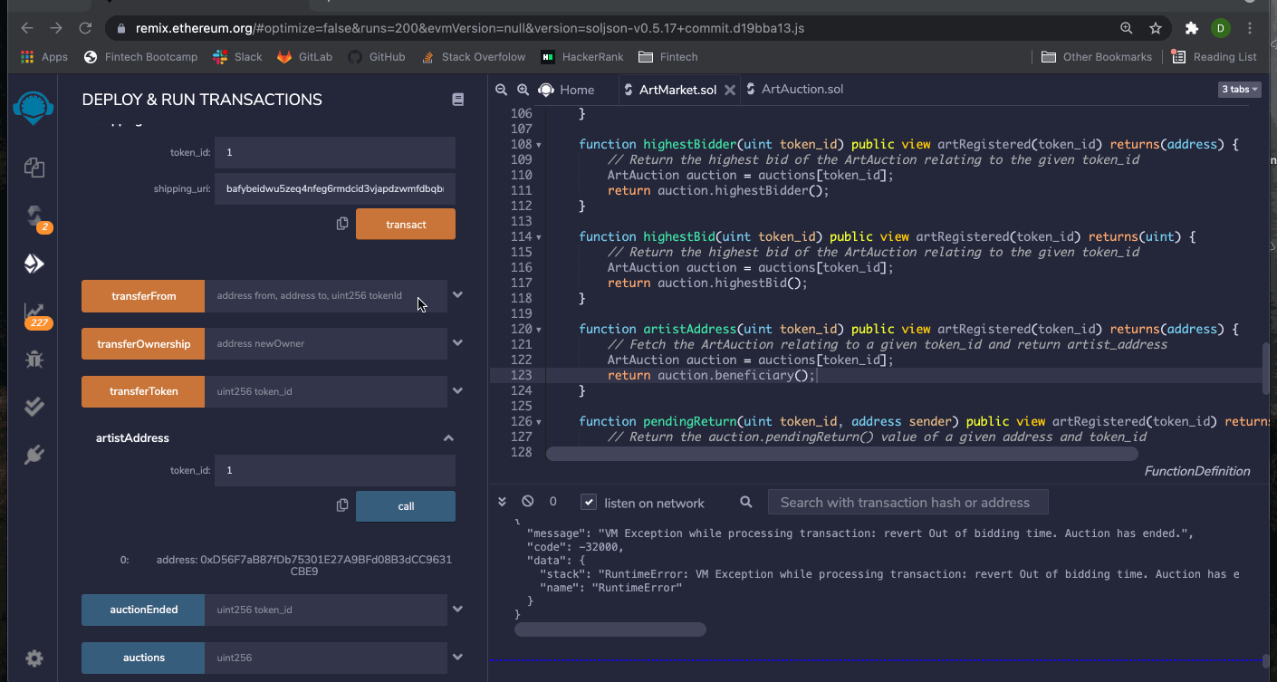
Customer Satisfaction Let’s assume Harry was satisfied with the Art he received.
Notes:
First, we verify again that Harry was in fact the high bidder of token 1
Since the auction house is never in possession of the artwork, we must rely on the buyer to verify the authenticity of the artwork. The auction house holds the token in escrow until the authenticity is verified via customer satisfaction
In this case, Harry approves and therefore the artwork is deemed authentic. Harry (Account 3 ending in 07fF) then reports back as satisfied (“True”) to the auction house
Upon verification that the buyer is satisfied, the auction house can release the token from escrow and transfer it to Harry, which he can then use as proof of ownership.
Only the auction house can transfer tokens.
When the token is transferred, the auction is finalized and the funds are transferred to the artist, minus a 3% commission fee which is transferred to the auction house

Slide 16

Customer Satisfaction
Remember Tom??
(Account 2 – E91d)
He won the Bid for Art 2
He received the Art successfully.
Unfortunately, he is not satisfied with the Art.
Let’s see how can he return the art back.
Notes:
Remember Tom? The high bidder for artwork 2?
Tom received his art but he was not satisfied
This means he will be returning the art to the artist
Luckily we have procedures in place for unsatisfied customers and everything will be recorded on our marketplace blockchain

Slide 17
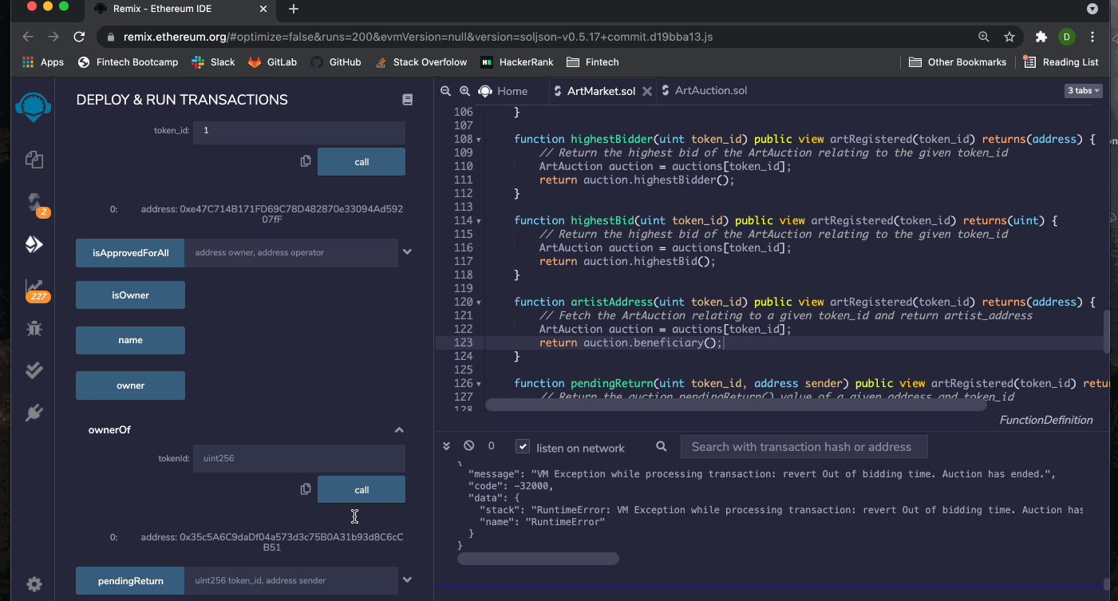
Customer Satisfaction Tom not satisfied with his Art
Notes:
Here we can see that Harry is now the owner of token 1 but the auction house is still the owner of token 2
We then verify that Tom was the high bidder for artwork 2 and that the auction is still open bc he has not yet reported back as satisfied or unsatisfied
Then, Tom (Account 2 E91D) initiates an art return and stores the shipping info associated with token 2 with a URI on the blockchain
He then reports back to the auction house as unsatisfied
T
he auction house then transfers his high bid back to his wallet and creates a new auction with the same token ID where other users can place new bids

Slide 18
Problem Solved
We’ve created a platform that allows for the safe creation, issuance, sale, and transfer of digital artwork online through our marketplace. What we built has applications beyond just digital artwork, like the efficient sale and transfer of anything online. This allows for disintermediation as well as increased efficiency and transparency for all users.

Slide 19
Future Plan
Amazon started with books we are starting with art!
Front End website
Donation to Art Charities
Royalty on each sale to the Artist
Ratings for Artist
Buy it now with premium
Supply chain of the material used to create the art

Slide 20

Questions?

